Slide 1

NBAC Annual Meeting 2020
NIEM 2021 Priority Planning
18 September 2020
Katherine Escobar

Slide 2




FACILITIES
Identify
Yourself
Please mute your mic when not talking
Speak Clearly
Disable Call Waiting.
This Session is being Recorded
Need Help, call Katherine Escobar
757-434-3291

Slide 3
Mr. Stuart Whitehead (SES)
Deputy Director, Cyber & Command, Control, Communications & Computers Integration, Joint Staff J6 &
Executive Director – NMO, US Department of Defense

Slide 4
NBAC Annual Meeting 2020
NIEM’s Path to the Future
18 September
Stuart Whitehead

Slide 5

NIEM, Pathway to the future
NIEM:
Where we’ve been
Where we are
Where we want to be ?

Slide 6
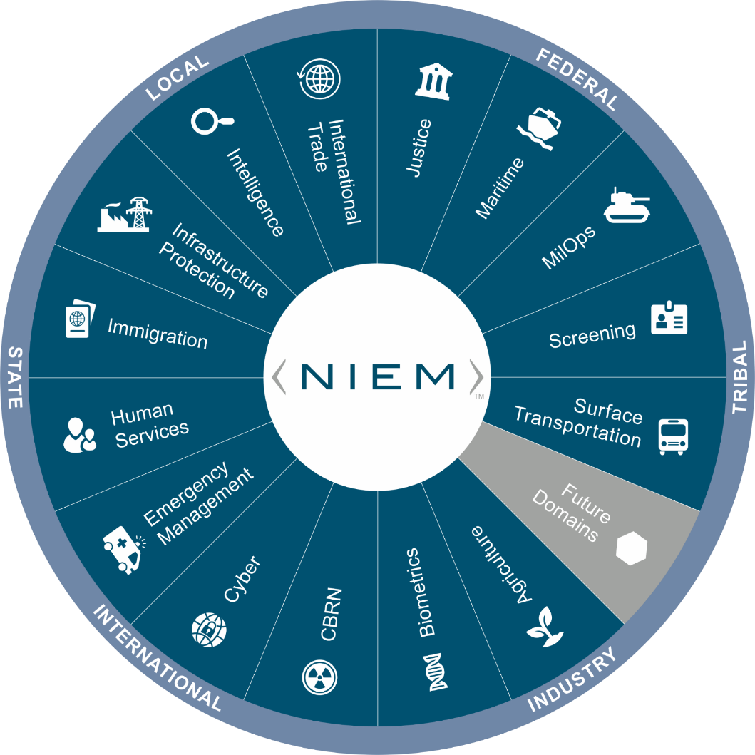
Where we’ve been – Where we are
Classic Data Silo Symptoms
  Manual, repetitive data manipulation and reporting tasks
  Creating “ad hoc” reports takes hours or days instead of minutes.
  There are several versions of the “truth” according to which system you select.
Top barriers to interoperability
  Difficulties in accessing relevant data : ICAM
  Lack of necessary skills/expertise : Data scientists
  Technology/system issues : Legacy IT/hard wired systems
  Data quality issues : Unintended/reuse
  Organizational silos vs. Enterprise approach
Notes:
Classic Data Silo Symptoms
Symptom 1: Organizations use analysts to support manual, repetitive data manipulation and reporting tasks on a daily, weekly, and monthly basis.
Business Impact – Analysts become bottlenecked doing tasks that can be easily automated. They spend all of their time prepping data and “working on” the data instead of “working with” the data to deliver reports, trends, and insights.
Symptom 2: Creating “ad hoc” reports takes hours or days instead of minutes.
Business Impact – Each time you want to answer a new question or modify your existing reports, someone has to program that new report or change. Real time analysis is impossible.
Symptom 3: There are several versions of the “truth” according to which system you select.
Business Impact – Data access is limited those who know all the nuances and have enough “tribal knowledge” to know what data sources to use and which ones to avoid. This produces further bottlenecks when attempting to deliver reports, trends, and insights.

Slide 7

Data Demands to support the organization
Scenario planning and forecasting
Budget and financial management
Program efficiencies
Financial risk management
Organizational transparency
Reporting
Common Operational Pictures
Decision ready data

Slide 8


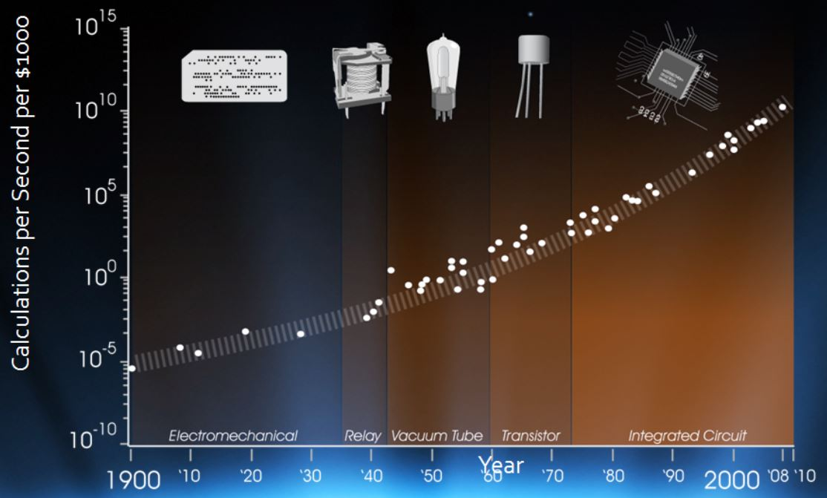

Where we are going
Interoperability as a Nation
Technology is making the world smaller, we need to foster machine to machine interoperability.
Keeping up with the speed of change, Data is at the heart of it all.
Emerging technologies
  Artificial Intelligence (AI)
  Cloud Computing
  Multi-dimensional Data
Competitively Intelligent on a Global scale!
Notes:
Moore's Law states that we can expect the speed and capability of our computers to double every couple of years, and we will pay less for them.
But there is hope. A new generation of tools and technologies is on the horizon. They hold the potential to transform the speed and ease at which companies can extract value from their data and form impactful insights—all while maintaining evolving security and compliance standards.

Slide 9

Where we want to be
Competitive Intelligence on a Global Scale
Enterprise data availability when and how its needed
International leader amongst global competitors
  2021 Focus
  Meta-model
  Internationalization
  NIEM as a Standard
  Domain Mentorship
  NIEM Content Maturation
  Increase NIEM Adoption
Position NIEM to meet the requirements of the future
Notes:
Meet the future’s information needs
Scalable Eliminate Data Silos via Automation
Replacing manual, repetitive tasks with automation

Slide 10
NBAC Annual Meeting 2020
NIEM 2021 Priority Planning
18 September 2020
Katherine Escobar

Slide 11
GROUND RULES
  Work together to
  stay on track
  Make your point
  and move on
  Debate IDEAS,
  not PEOPLE
  Ask questions if you have questions
  Be engaged and acknowledge each others’ contributions
  Share new ideas
  and be innovative!

Slide 12
NBAC Annual Meeting SESSION schedule
Session Date & Time |  | Session Topic | Planned Speakers | Facilitators
1 | Monday, 14 Sept 10 a.m. – Noon EDT | Advancing NIEM Adoption | Kshemendra Paul NIEM Executive Steering Council | Kamran Atri Thomas Krul
2 | Monday, 14 Sept 1 – 3 p.m. EDT | State, Local, Tribal Tiger Team | Eric Sweden National Association of State Chief Information Officers (NASCIO) | Cait Ryan, Tom Carlson Thomas Krul
3 | Tuesday, 15 Sept 10 a.m. – Noon EDT | Supporting Domain Growth | Brian Gattoni DHS CISA CTO | Kamran Atri Thomas Krul
4 | Tuesday, 15 Sept 1 – 3 p.m. EDT | Emerging Technologies Tiger Team | Syed Mohammed Director, US Department of Homeland Security, Modeling and Simulation Technology Center | Jalal Mapar Lain McNeill
5 | Wednesday, 16 Sept 10 a.m. – Noon EDT | Improving NIEM Implementation | Jon Kirk, Patrick Lagioia Treasury Board of Canada | Thomas Krul Kamran Atri
6 | Wednesday, 16 Sept 1 - 3 p.m. EDT | International Tiger Team | Poewan Lau | Thomas Krul Kamran Atri
7 | Thursday, 17 Sept 10 a.m. – Noon EDT | NIEM Release Planning | Working Session | Christina Medlin Web Roberts
8 | Thursday, 17 Sept 1 - 3 p.m. EDT | NBAC/NTAC Collaboration Planning | Working Session | Kamran Atri , Webb Roberts Thomas Krul, Scott Renner
9 | Friday, 18 Sept 10 a.m. – Noon EDT | NIEM 2021 Priority Planning | Stuart Whitehead NIEM Executive Director | Katherine Escobar Stephen Sullivan
10 | Friday, 18 Sept 12 -12:15 p.m. | Annual Meeting 2020 Wrap-up |  | Kamran Atri Thomas Krul Stephen Sullivan

Slide 13
Reminder:
Well-informed decisions will be taken, recorded, and carried out.
Your full participation is a must to ensure success.
Following the agenda we all agreed on, with time limits on topics.
Hear to learn from one another with open mind.
Don’t be shy, speak up when you have something to say.
Ask questions if you are unclear or unsure… share your views.
We will abide by decisions which will be decided during this NBAC/NTAC F2F, whether we agree with them or not.
Sometimes its lonely out there, build your network here with you fellow data standards guru.
Every NBAC member is directly part of the NIEM decision-making process.

Slide 14
Executive Focus
Promote Adoption and Growth
  Registry/Repository – Re-use
  Tools aligned with NIEM Lifecycle
    Improve current, but look to the future
  Review/ Improve Processes
    Consolidate, Streamline & Publish
Encourage Greater State, Local & Tribal Participation
Keep Focus on Emerging Technologies
Move Toward Model Maturity
Improve Business Model Processes/Practices
  Governance
  Outreach
  Standard Practices
Embrace Internationalization
Continue to Aggressively Pursue “Virtual” and Live Engagement Opportunities

Slide 15
current - NIEM Domains and Adoptions
Domains | STEWARD/Organization
Agriculture | VACANT, Garon Reeves/ USDA OCIO
Biometrics | John Boyd, Satish Sripada, Jennifer Stathakis, William Graves, Diane Stephens/ DHS OBM, DHS OBIM, FBI, DoD PM BIO, NIST
CBRN | Brendon Plapp/ DHS
CYBER – NEW FY 20 | Brian Gattoni, Preston Werntz, Juan Gonzales/ DHS CISA
Emergency Management | Dan Cotter, Kamran Atri/ DHS, A4SAFE-DHS
Human Services | Tom Carlson, Dorothy Wan/ HHS AFC
Immigration | Curtis Ross, Jennifer Kish/ DHS USCIS
Infrastructure Protection | Preston Wertz, Juan Gonzales/ DHD CISA
Intelligence | Sue Dorr/ ODNI
International trade | Thomas Mills, Shailesh Sardesai DHS CBP
Justice | Kate Stilhol/ Nlets
Maritime | Sandra Brown, Kelly McCool/ OPNAV N9ID, N2N6IB
MilOps | Jeffery R. Jones, Ralph O’Connell/ JS J6
Screening | Steve Yonkers/ DHS
Surface Transportation | Dan Morgan/ DOT
ONBOARDING | STEWARD/Organization
Statistics | TBD, Chris Carrino/ Census Bureau

Slide 16
potential - NIEM Domains and Adoptions
Domains | Organization/POC
Health | Health and Human Services/ TBD
METOC/NOAA | National Oceanic an Atmospheric Administration /Kevin Jackson/
Logistics | US Transportation Command / James Decarli
Humanitarians Aid | US Agency for International Development/ Brandon Pustejovsky
Bureau of Reclamation | US Department of the Interior/Andrew Marquat
General Administrative Services | Treasury, Office of Management and Budget, General Services Administration
Military Service Member | Veteran Affair/ Kshemendra Paul
Education | TBD
ADOPTIONS | Purpose
Department of Education | Create IEPDs, exchanges
FEMA Grants | Explore establishing common vocabulary
FEMA Food Insurance & Mitigation ADM (FIMA) | Learning more about NIEM, exchanging training materials & exploring initial use case and value proposition
NOAA Fisheries | Learning more about NIEM, exchanging training materials & exploring initial use case and value proposition
Treasury Department (DAIMS) | Learning more about NIEM, exchanging training materials & exploring initial use case and value proposition

Slide 17
FY2020 DOD NIEM Successes
NIEM 4.2 Minor Release (Nov 2019)
NIEM 5.0 Major Release (SEP 20) and initiate 5.1 minor
MIL-STD-6040 US Message Text Format (USMTF) NIEM conversion to NIEM (60% complete)
Link 16 XML instantiation guidance – need wording
Defense Counterintelligence and Security Agency (DCSA) DoD Contract Security Classification Specification content into MilOps 4.2 (Dist C/D)
NATO Core Data Framework (NCDF) Datalake (NIEM in NATO)
Federated Mission Network (FMN) Spiral 4 Specification Package (Apr)
Adopted as FVEY Combined Communication-Electronics Board objective - n
NATO Alliance Future Surveillance and Control (AFSC) program adoption
  Conduct a robust strategic communications engagement
NATO Core Data Framework (NCDF) = NIEM
Notes:
Defense Counterintelligence and Security Agency (DCSA) DoD Contract Security Classification - NIEM conformant DD 254 document Automated via NIEM saving time and money

Slide 18
FY2020 DOD NIEM Successes Cont.
  IEPD Registry/Repository completed requirements analysis and development start
  IEPD Development Tools completed requirements analysis and development start
  Implementation of baseline Meta-model transitioning NIEM to language agnostic vs. XML
  Defense Acquisition University development of Program Management course (Oct. 1 Launch)
  Emphasize integration with emerging technologies – Meta Model (AI, Cloud, Cyber, JSON)
  Mature international alignment (Canada, FVEY, NATO)
  Two domains in the offing: Statistics, Health
  Lay foundation for a strong 2020/2021 state, local, tribal engagement
Notes:
Defense Counterintelligence and Security Agency (DCSA) DoD Contract Security Classification - NIEM conformant DD 254 document Automated via NIEM saving time and money

Slide 19
Remainder of CY2020 NMO Work Plan
NIEM Management Office Products Define Registry/ Repository Rqts (Jun) Define “baseline” tool strategy (Jun) Identify transition leadership HEALTH COI (Aug) ESC ready “baseline” Tool strategy (Sept) ESC ready Meta-Model Strategy (Sept) IEPD Registry (Oct) Best of NIEM Awards (Oct) Integrated UML Strategy (Nov) NIEM Model Maturity way ahead (Nov) CY2021 Work Plan (Dec) | NIEM Workshops NBAC (monthly) NTAC (monthly) ESC virtual (Mar, Jun) NMO/NBAC/NTAC virtual Mtg (Aug-Sep) Cyber Stakeholder Meeting (Aug) HEALTH COI Symposium (Aug) ESC virtual (Sep) Statistics Stakeholder Meeting (Sept) NMO/NBAC/NTAC F2F (Oct) New NBAC co-chair (Oct) ESC F2F (Dec)
Strat Comm Outreach Emerging Technology Tiger Team re-focus (Jun) NATO Data Management (Jul) NASCIO Webinar (Jul) NASCIO Event (Oct) NATO C3 Outreach (Oct) NIEM Data Summit (Nov) | NIEM Community Deliverables NIEM.gov updates (monthly) AI and NCDF Data Lake (Jun) Stand up State, Local, Tribal Tiger Team New domain stand up (Jul) NIEM 5.0 Release (Oct) “on track” NCDF Data Lake FMN Spiral 5 (Dec) JSON Spec (Dec)
DOD Leadership and Resource Sponsor Input Desired

Slide 20
FY2021 focus area
Tentative Major Goals
  Advance Met-model implementation
  Plan execute 5.1 minor release
  Implement International localizations to use NIEM
  Improve and launch additional NIEM training
  Emphasize integration with emerging technologies (priority of AI, Cloud, Cyber)
  Establish persistent NIEM and NCDF Data Lake instantiation
  Onboard Statistics Domain
  Explore new domains: METOC, Humanitarian Aid. Dept. of Reclamation
  Encourage New Adopters: Education, NOAA Fisheries, Treasury (DAIMS), Veterans Affairs
  Strong state, local, tribal engagement
DOD Leadership and Resource Sponsor Input Desired

Slide 21
2021 NBAC work Recommendations
  NBAC Monthly Meetings 2021
  NBAC Annual Report 2021
  Continue with the Tiger Team Initiatives
    International
    Emerging Technology
    State Local Tribal
    IEPD
  Revisit NIEM cost model & supporting develop slides demonstrating the cost/benefit of NIEM
  Assist NIEM PMO
    Modernizing the NIEM Training Material
    Evaluating the newly structured NIEM Tools
    Onboard new NIEM Domain
    Assess and support NIEM Registry development
  Advance NIEM Adoption
    Engage GAO and showcase NIEM
    Use GAO Report to setup outlier
  Support Domain Growth
    Consider mentorship program between Domains
  Improve NIEM Implementation (including Release plans)
    Revisit tools such as Self Assessment
  Take Active Role in New Domain Onboarding
    Statistics
    Health
    NOAA
    VA
    Treasury
    Public Works /Safety
    Grants
  Strengthen NBAC and NTAC Collaboration

Slide 22
2021 NTAC work Recommendations
  Advance NIEM Meta Model
  5.1 Release
  Support Tiger Team Initiatives
    International
    Emerging Technology
    State Local Tribal
    IEPD
  Take Active Role in New Domain Onboarding
  Strengthen NBAC and NTAC Collaboration

Slide 23
NMO CY2021 Work plan
Four work categories
  NIEM Management Office Products
  NIEM Workshops
  Strategic Communication Outreach
  NIEM Community Deliverables
Inputs from:
  ESC
  NTAC (monthly)
  NBAC (monthly)
  Two virtual ESC sessions (Mar and Jun 2020)

Slide 24
NMO Tentative FY2021 Work Plan
NIEM Management Office Products “Baseline” Tool strategy Implementation (continues Q1-Q2) IEPD Registry implementation (continues Q1-Q2) DAU PM Course Launch (Q1) Best of NIEM Awards (Sept) CY2022 Work Plan (Sept) | NIEM Workshops NBAC (monthly) NTAC (monthly) ESC virtual (Dec, Mar, June, Sept) NMO/NBAC/NTAC Annual (Sept) New NBAC co-chair (Oct) ESC F2F – Covid lift (Jun, Dec)
Strat Comm Outreach Refresh NIEM.gov NIEM.gov bi-lingual (French/English) Quarterly success story highlights | NIEM Community Deliverables NIEM.gov updates (monthly) NIEM 5.1 Minor Release (Oct) Refresh NIEM Training Material Establish Training Pool
DOD Leadership and Resource Sponsor Input Desired to potential domains

Slide 25


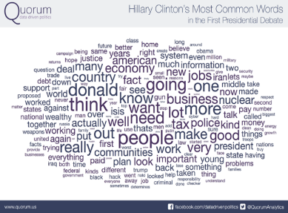




Presented by:
Kamran Atri, Thomas Krul &
Katherine Escobar
katri@A4SAFE.COM
Thomas.krul@canada.ca
katherine.b.escobar.civ@mail.mil
Co-Chairs of NIEM Business Architecture Committee (NBAC)
NIEM PMO

